Slide 1
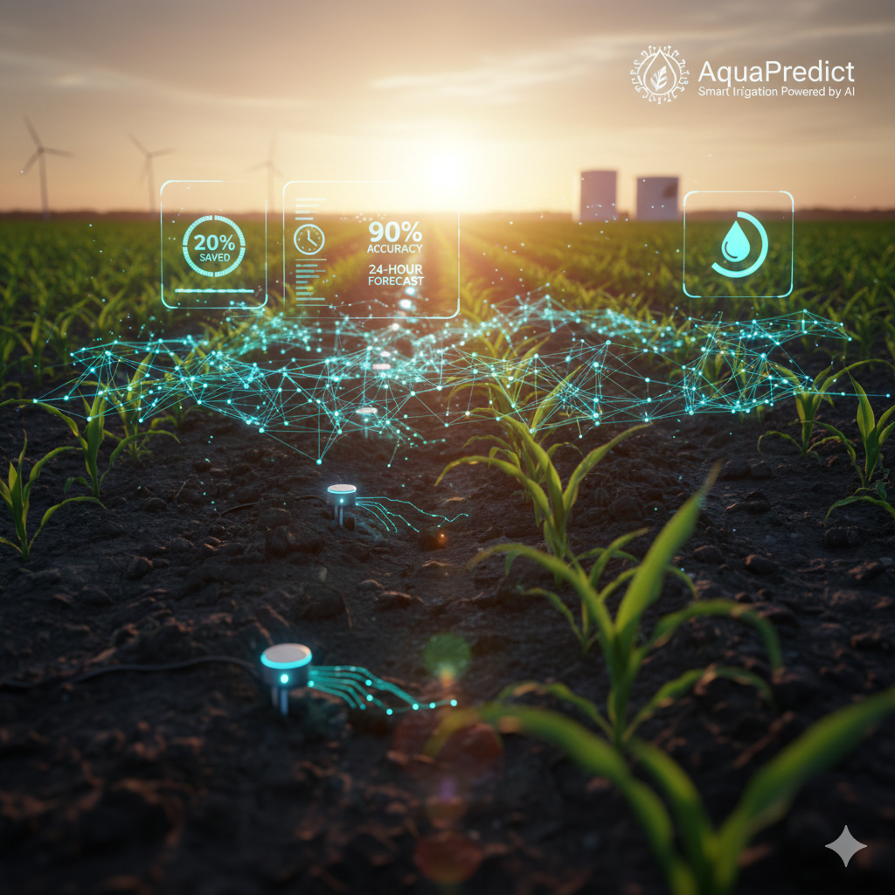

AquaPredict: Leveraging IoT and Machine Learning for 24-Hour Predictive Irrigation
Aleyna ÇALIŞKAN, Mert BAĞCI, Yusuf DEMİR

Slide 2
Problem Statement & Objectives
The Core Problem: Reducing water wastage and optimizing crop health in large-scale agricultural zones via data-driven decisions.
Mission: To classify and predict irrigation needs for the upcoming 24-hour window based on real-time sensor streams.
Business KPI Targets:
20% reduction in total water consumption.
5% increase in overall crop yield.
Minimum 90% classification accuracy for irrigation alerts.

Slide 3
Project Scope & Boundaries
In-Scope Activities: Automated data ingestion from soil moisture sensors and weather stations.
Data integration pipeline with a maximum 5-minute latency requirement.
Real-time API development for agricultural decision support.
Out-of-Scope (Constraints): Physical procurement or installation of IoT hardware/sensors.
Legal liabilities, insurance, and long-term hardware maintenance.

Slide 4
Risk Management & Mitigation
Data Reliability Risk:
Privacy & Security:
Technical Challenges:
Addressing faulty sensor data through imputation and automated health monitoring.
Implementing geographic data anonymization and encryption for field coordinates.
Managing model drift and seasonality through regular retraining triggers and human-in-the-loop verification.

Slide 5
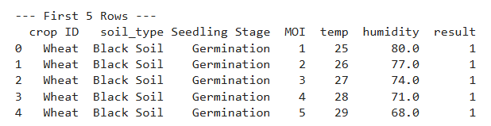
Data Sourcing & Strategic Justification
1
Dataset Selection:
2
Operational Cadence:
Utilization of the Smart Agriculture Dataset, providing 16,411 instances for high-granularity modeling.
The system is built to process data packets arriving at 30-minute intervals, mirroring real-world IoT sensor deployments.
3
Key Indicators:
Analysis focuses on Moisture Index (MOI), Ambient Temperature, and Relative Humidity as the primary drivers of irrigation needs.

Slide 6
Data Quality & Preprocessing Pipeline
Integrity Validation: Execution of df.info()
confirmed zero missing values across 16,411 records, ensuring a seamless prediction window.
Logical Boundary Checks: Temperatures validated within the 13-46°C range.
Humidity validated within the 15-91% range.
Encoding Strategies: Transformation of qualitative features (Soil Type, Seedling Stage) into numerical formats via One-Hot Encoding for model intake.

Slide 7
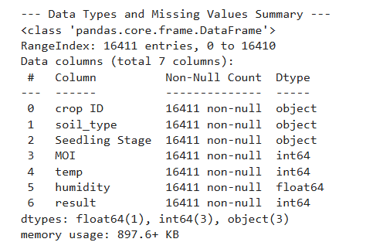
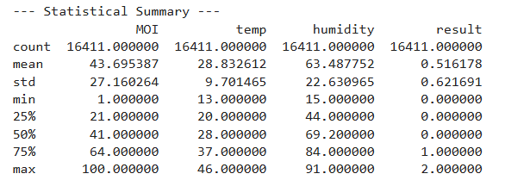

Slide 8
EDA & Domain Insights
Correlation Analysis: Identified significant moisture (MOI) depletion patterns during peak daytime temperature spikes.
Statistical Verification: Confirmed that MOI values (1-100) are logically distributed, providing a solid baseline for classification.
Insight: The data shows moisture levels are heavily influenced by ambient humidity, suggesting a multi-variate modeling approach is necessary.

Slide 9
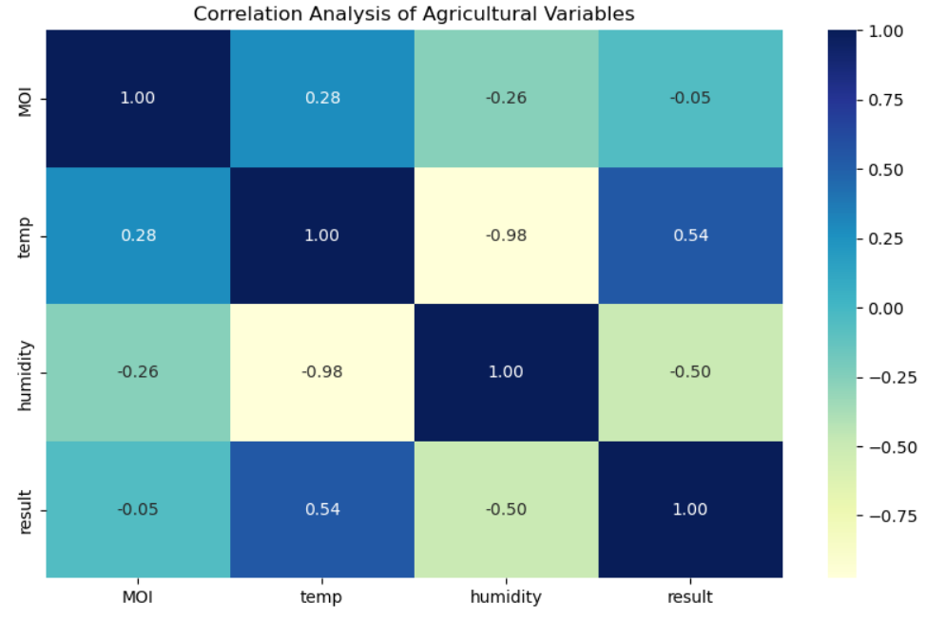
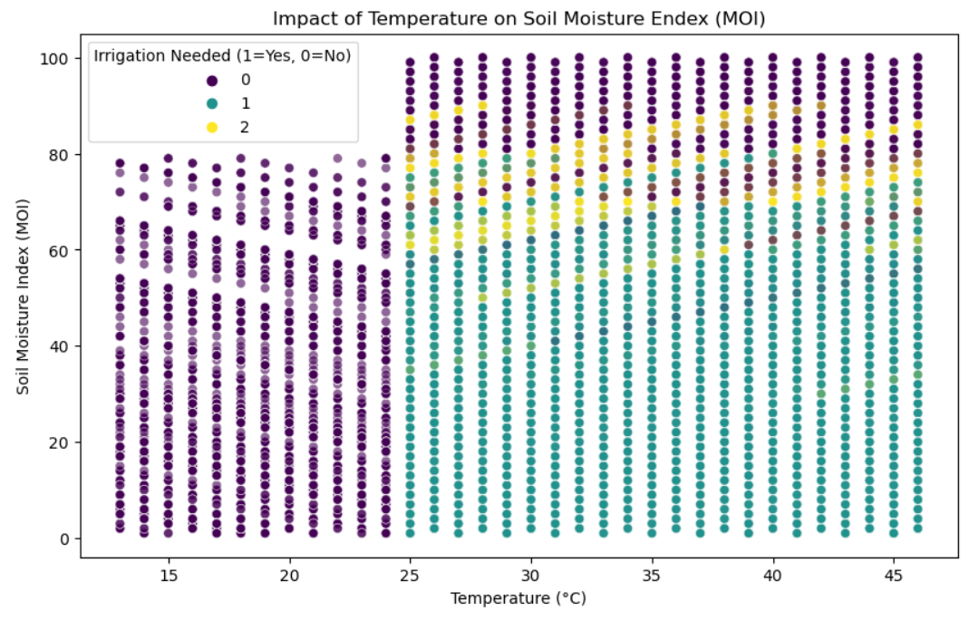

Slide 10
Baseline Modeling Strategy
Model Selection: Implementation of Logistic Regression and Decision Trees to establish a performance benchmark.
Optimization Goal: Beyond accuracy, the model focuses on Recall to minimize "False Negatives" ensuring no crop is left without water when needed.
Evaluation: Planned use of region based cross validation to ensure model robustness across different field conditions.

Slide 11
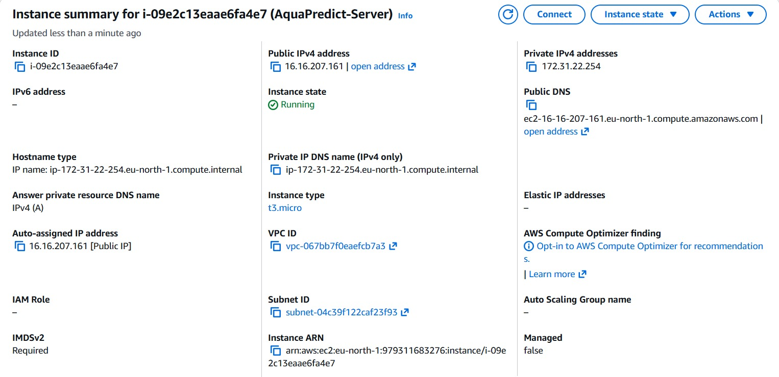
AWS Cloud Deployment & Scaling
Platform: Hosting the final application on an AWS EC2 (t3.micro) instance to leverage cloud scalability.

Slide 12
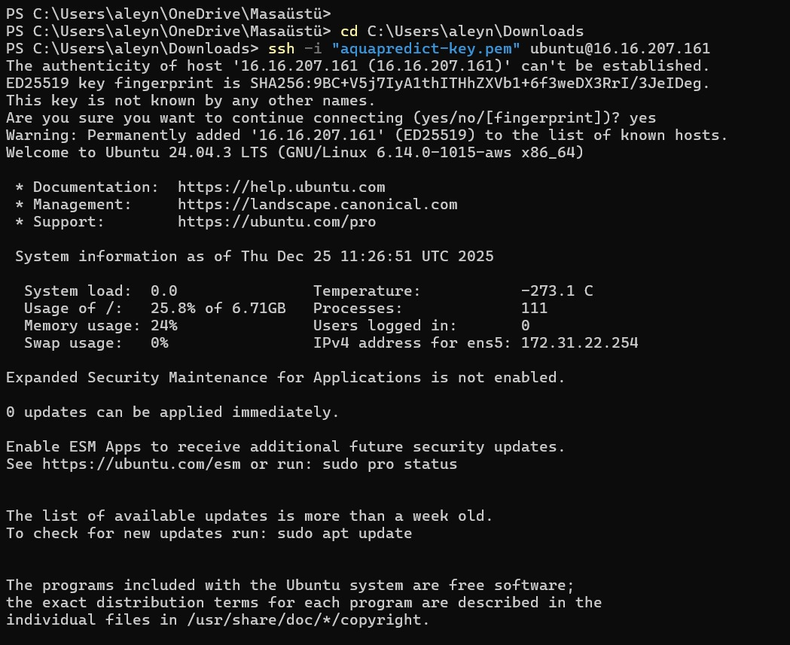
OS & Environment: Configured Ubuntu Server 22.04.3 LTS environment optimized for Python-based ML workflows.

Slide 13
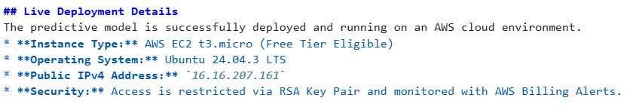
Cloud Security: Utilization of Security Groups to manage SSH and Port 8501 (Streamlit) access.
Account protection via Virtual Card integration and Billing Alerts.

Slide 14
Conclusion & Project Roadmap
Current Status: Successfully completed data ingestion, sound cleaning, and infrastructure setup on GitHub.
Future Work: Pilot testing of the PoC over a 4-8 week period to measure actual water savings.
Final Deliverable: A production-ready API and dashboard meeting the 5-minute latency threshold for real-time operation.

